Slide 1
NAFCU/PAC Overview
Name / Title

Slide 2
WHAT IS A POLITICAL ACTION COMMITTEE?
Collective Resource
Like minded individuals, connected by issues, beliefs or employment.
Pooled collective resources to support a specific candidate, committee, or issue.
Engagement Mechanism
Corporations are prohibited from directly contributing to federal candidates – but they may operate a PAC.
A PAC is strictly regulated by the FEC and only allows for voluntary, individual contributions under stringent guidelines for participation.
A PAC is a legal, transparent and federally monitored means of expressing united interests with one powerful voice.
Legal & Transparent
Financially supporting candidates is the only thing a company/organization cannot do for itself and relies strictly on the eligible individuals for voluntary support.
A PAC is power in numbers to amplify the education and voice of an organization.

Slide 3
Why have a pac?
Advocacy
Relationships
Visibility
Investment
A PAC is another engagement lever for increased advocacy efforts by your Government Relations team.
A PAC enables you to build, foster,
and maintain relationships and show support for candidates who support NAFCU priorities.
Participation in political and campaign events raises your visibility and facilitates engagement by company leaders in the political process.
Operating a PAC signals to lawmakers and your peers that you are invested in the collective future of your industry and organization.

Slide 4


nafcu/pac Purpose
Protect
Advocate
Having elected officials who support your interests is key to protecting your ability to operate.
A PAC is one of the best tools for growing the ability to advocate for policies important to your industry.
Advance
Educate
A strong and consistent voice in the political sphere advances your organization’s goals and interests.
Educating policymakers on our industry helps them make informed decisions that benefits credit unions today, and in the future.

Slide 5




NAFCU/PAC policy priorities
Tax Issues
The NAFCU Government Relations team is dedicated to the relentless pursuit of a favorable financial and regulatory environment.
We proactively engage on issues that can advance the credit union movement and seek to mitigate threats to our operations and the communities we serve.
Regulatory Relief
Data Protection
Issues include:
Housing Finance Reform

Slide 6




NAFCU/PAC contributions
NAFCU/PAC supports candidates who align with our advocacy goals to advance favorable policies for credit unions and mitigate risks to operations.
Member with large industry presence
Reputable and known industry supporter and/or champion
Candidates are carefully vetted based on the following contribution criteria:
Serve on relevant committees to this industry
Leadership role in Congress

Slide 7
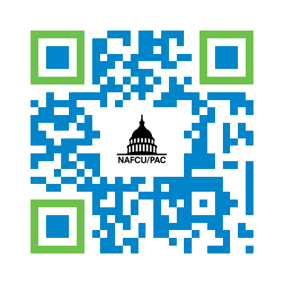
Together, we can further the credit union movement
1
Logon to NAFCUPAC.com or scan the QR code to make a voluntary contribution.
2
Select the dollar amount and method.
3
Engage throughout the year with colleagues and the NAFCU team.

Slide 8
FEC REQUIRED DISCLAIMER
DISCLAIMER: Contributions to NAFCU/PAC are not deductible for Federal income tax purposes. Federal election law requires political committees to use best efforts to report the name, mailing address, occupation, and name of employer of individuals whose contributions exceed $200 during a calendar year. An individual may not contribute more than a total of $5,000 per calendar year to the committee. Federal law prohibits contributions to the committee from the general treasury funds of a corporation, labor organizations or national banks (including corporate or other business entity credit cards), from any person contributing another's funds, from a Federal government contractor, or from a foreign national who lacks permanent resident status.

Slide 9



NAFCU/PAC TEAM
Allyson Gale
Senior Director of Political Affairs
agale@nafcu.org
216-469-4908
Meghan Brady DiPisa
Senior Associate Director of Political Affairs
mdipisa@nafcu.org
703-842-2837
Eric Sneddon
Government Affairs Assistant
esneddon@nafcu.org

